Slide 2
Welcome to the
Smooth Rock Falls
Hospital FOUNDATION

Slide 3
History
With a view to answer the capital needs of the Smooth Rock Falls Hospital, in 2013-2014, a group of people decided to do fundraising activities. They quickly realized that in order to obtain various funds, it was preferable to become an incorporated entity.
A rather lengthy process to become a charitable organization was started and in 2016 we were incorporated.
Founding Members : Marielle Cousineau, Chantal Tessier,
Melonie Loubert, Wayne McGee, Fabien Hébert

Slide 4
Goals and mandate
Sustain the capital needs of the Smooth Rock Falls Hospital

Slide 5
Board of Directors members
2023-2024
Marielle Cousineau, chairperson
Mérianne Latour, vice-chairperson
Melonie Loubert treasurer
Carole Cloutier, secretary
Lina Arseneault, member
Hélène (Gervais) Gillissie, member
Suzanne Boivin, member

Slide 6
Board of Directors members
2024-2025
Marielle Cousineau, chairperson
Mérianne Latour, vice-chairperson
Melonie Loubert treasurer
Carole Cloutier, secretary
Lina Arseneault, member *
Hélène (Gervais) Gillissie, member
Suzanne Boivin, member
Angèle Marchand, member
* Resigned december 2024

Slide 7
Recognition policy
Policy
The Fondation HSRFH Foundation recognizes donors for their gifts through formal and informal, personal and public expressions of appreciation. The Foundation and the Smooth Rock Falls Hospital recognizes the importance of the contributions to the Foundation and reiterates the right of donors to receive proper recognition and appreciation for their donations.

Slide 8
Procedure
The foundation will acknowledge receipt of all gifts and or donations received in an effort to express gratitude and support for its foundation.
A TV screen depicting a Power Point Presentation is erected in a designated area of the hospital (atrium) as a wall of recognition.
Donor Recognition Guidelines will be as follows

Slide 9
Legend
Under $100.00 Receipt and thank you card
Over $100.00 /under $ 500 A thank you card from the Foundation will be sent to the donor
Over $ 501 / under $4,999 A thank you letter from the Foundation President and Hospital CEO will be sent to the donor
over $5,000 / under $9,999 Bronze acknowledgement under the title of Collaborateur
/ Partner
over $10,000 /under $24,999 Silver acknowledgement under the title of Bienfaiteur / Benefactor
over $25,000 / under $49,999 Gold acknowledgement under the title of Bâtisseur / Builder
over $50,000 / under $99,999 Platinum acknowledgement under the title Fondateur / Founder
over 100,000 + Dedication of a space in the Hospital i.e., room with a negotiated timeframe under title of Visionnaire / Visionary

Slide 10
4. Donors,who should be recognized, is defined as all individuals, corporations, service clubs, community organizations, and philanthropic foundations who make monetary gifts or gifts-in-kind donations to the Fondation HSRFH Foundation. These gifts may include donations to capital campaigns, direct mail, email or facebook requests, memorials, tributes, endowments, special events, etc.
5. A donation or gift may be in different forms
  Gifts of cash
  Gifts-in-kind
  Life insurance
  Non-revocable gifts (i.e. planned gifts)
  Bequests
  Pledges
  Sponsorships or third party events resulting in revenue for the Foundation

Slide 11
6. The HSRFH Foundation may amend its recognition policy from time to time in order to enhance and maintain the purpose of its policy in terms of equitable recognition and/or qualitative recognition.
7. The names of persons, companies, organizations or agencies donating to the Foundation will remain confidential until such time as they are published according to the Recognition guidelines (article 3).
8. The donor may request anonymity from public display.
9. Specific amount of a donation and terms of payment will be considered confidential at all times unless donor indicates otherwise in writing. i.e., donation amount

Slide 12
10. Access to information will be limited to Foundation staff and board.
11. Gifts will be acknowledged promptly and donors advised of the recognition policy.
12. Donor Wall will be up kept as deemed necessary.

Slide 13
Visionary ($100,000 +)
Mrs. Jeanne Renaud – 2014
The living room in the acute care unit is named in memory of Mrs Jeanne Renaud
The Marcel and Frances Labelle Foundation – 2017
The x-ray department is dedicated to the Marcel and Frances Labelle Foundation
The Marcel and Frances Labelle Foundation – 2020
Mrs Lise and Mr Denis Gauvin - 2024

Slide 14
Founder ($50,000 - $99,999)
Monkman Family Foundation – 2020
A plaque is placed in the flower garden by the gazebo, in memory of Raymonde and Rhéal Arseneault

Slide 15
Builder ($25,000 - $49,999)
La Caisse Populaire de Kapuskasing et région – 2017
La Caisse Populaire paid for the purchase of a defibrilator
La Caisse Alliance de Kapuskasing et région – 2020
La Caisse Alliance made a donation towards the Aging at Home accessible van

Slide 16
Benefactor (10 000 $ / 24999 $)
Estate of Mrs Pearl Marlow- 2020
Angèle Bizier in memory of her spouse Roger Bizier
Angèle made a donation towards the purchase of an accessible minivan for the Aging at home Program
Monkman Family Foundation – 2023
Richard and Mona made a doation to help us refurbish and maintain the back yard of the Long Term Care Unit.
Agnico Eagle – 2024
This mining company made a donation towards the purchase of a specialized bed and mattress.

Slide 17
Partner ($5,000 - $9,999)
TransCanada Pipelines Limited 2017
GEMINI – SRF Power Corp 2023
Ontario Power Generation (OPG) 2025

Slide 18
Donations of $1,000 or less than $4,999
2020
Royal Canadian Legion – Br 305
André Bernier
Claudette Rousseau
Denis Lasalle

Slide 19
Donations of $1,000 or less than $4,999
2021
Jean-Yves Marquis
Donation in memory of Jean-Louis Dubord

Slide 20
Donations of $1,000 or less than $4,999
2022
Nicole Wittke Thomas Boyd
Chevaliers de Colomb

Slide 21
Donations of $1,000 or less than $4,999
2023
Lina Arseneault Smooth Rock Falls’ Lions Club

Slide 22
Donations of $1,000 or less than $4,999
2024
Yvette et Reg Keat
2025
Patrick Renaud

Slide 23
Dons de 100$ et moins que 1 000$
2022
Anita & Ronald Rochon Patricia & Michel Dubord Lina Arseneault
Patrick Phelan David & Margaret Pachota Lucienne Bernier
Patricia & Michel Dubord Guy Rochon Diane Papineau
Alayne & Jean-Marie Couture Mariette & Léonce Fortin Hélène Ménard
Chantal Marchand Deborah Foster Claude Goulet
Yvon Bernard Stella Drolet Madeleine Gravel
Town of Smooth Rock Falls Mérianne Latour Yvon St-Pierre
Terry & Mavis Pinkney Université de Hearst /Innovanor
Laurie & Lorraine Breault Alexis Klimack Anonymous
Dan & Marg Therrien Anonymous Claude Goulet
Theresa Roberts Anonymous Suzanne Martin
Irène Gravel Edmonde Guindon Solange McNeely
Cercle Ste Thérèse de l’enfant Jésus Claude Goulet
Clara & Emile Jacques George Long Diane Richard
Suzanne & Guy Boivin Hélène Gillissie Hélène Gillissie
Aline Ménard Yvon Bernard

Slide 24
Donations of $100 $ or less than $1 000
2023
Eliane Labonté Bernier Rose Marie Smith Stephanie Townsend-McKinnon
Michel Brideau Claude Goulet Anonymous
Gaetan Mercier Anonymous Noel Mercier
Ruth Ann Leroux Claude Goulet Margaret& David Pachota
Claude Goulet La famille Ubald Mercier Sue & Guy Boivin
Claude Goulet Claude Goulet Claude Goulet
Claude Goulet Barry Adamson Beth Berdon
Claude Goulet Patrick Whelan Patrick Whelan
Marie & Claude Pelletier Dianna & Thomas Rennie Denis Lasalle

Slide 25
Donations of $100 and less than $1000
2024
Claude Goulet Casandra Gravel Branda Yan
Susan Booth Anonymous Claude Goulet
Tom Vane Colette Cooper Kathy Taylor
Clara Martin Anne-Marie Hosick Claude Goulet
Claude Goulet Claude Goulet Claire Stasila
Claude Goulet Madeleine Gravel Claude Goulet
Claude Goulet Jean-Yves Marquis Claude Goulet
Famille de Gaston Gravel Mireille Bernier Claude Goulet
Denis Lasalle Claude Goulet Claude Goulet
Ken & Jeannine Grenier

Slide 26
Donations of $100 and less than $1000
2025
Rhissy Emmanuel Gnagna Claude Goulet Joh Christian Agbayani
Claude Goulet Denis Brûlé & famille Jacynthe Leroux
Claude Goulet Claude Goulet Carole Doucet
Thomas & Dianna Rennie Claude Goulet Claude Goulet
Smooth Rock Falls Hospital Auxiliary Anonyme
Jeannine, Denis, Claude, Alain et Pierre Brûlé Lloyd Rosebush
Claude Goulet Louis Poirier Claude Goulet
John Christian Agbayani

Slide 27
Donations up to $100
2022
Yvon Bernard Lise & Lawrence Simpson Hélène et Jean-Guy Poirier
Tracy & Chantale Tessier Susan Therrien Line Thériault
Luc Albert Conrad Labonté Éliane et André Bernier
Claudette Galipeau Denise & Daniel Pelletier Pauline & Carol Labonté
Jacqueline Fortier Christiane & Serge Labonté Marielle Cousineau
Hélène Gillissie M Chaney Richard & Line Mercier
Nancy Mercier-Lacroix Anonyme Anonyme
Clara & Emile Jacques Kathy Taylor Kathy Taylor
Marcel & Judith Lévis Kathy Taylor Lise Simpson
Hélène Gillissie Clara & Emile Jacques Kathy Taylor
Judith & Marcel Lévis Nicole & Jean-Yves Leblanc Lloyd Rosebush
Nicole & Jean-Yves Leblanc Barbara Burkhardt
Nicole & Jean-Yves Leblanc Normand Lévis
Yvette & Rej Keat Paul Hébert Yvette & Rej Keat
Rachel & Denis Therrien Marie & Ernest Demers Joanne McGee
Alayne and Jean-Marie Couture Alayne and Jean-Marie Couture

Slide 28
Donations up to $100
2022
Yvon Ward Denise Couture Lynn & Gilbert Pelletier
Line Thériault Pierre Plamondon Linda Miville
Francine Gagnon Monique Boucher Monique Boucher
Leslie Gagnon Leslie Gagnon André Wilson
Nicole Gagné FEESO Lucie Viel
Nicole Forley Yvonette & Maurice Demeules
Kathy Taylor Kathy Taylor Kathy Taylor
Nicole & Jean-Yves Leblanc Raymond Lévis
Nicole & Jean-Yves Leblanc Mariette Gervais
Mariette Gervais Alayne and Jean-Marie Couture
Alayne and Jean-Marie Couture Kathy Taylor
Alayne and Jean-Marie Couture Kathy Taylor
Kathy Taylor Mariette Gervais Lynne McMann
Mona Monkman Maurice Arseneault Diane Papineau

Slide 29
Donations up to $100
2022
Sylvie et Walter Laconi Dianne et Ron Browne Hélène Gillissie
Leslie et Denis Gagnon Suzanne & Guy Boivin Hélène Gillissie
Lise et Laurence Simpson Hélène & Jean-Guy Poirier Kathy Taylor
Dianne et Ron Browne Chantale & Tracy Tessier Kathy Taylor
Yvonnette & Maurice Demeules Lucette Lamothe Lyse Granier
Yvette & Reg Keat Alayne & Jean-Marie Couture Lyne Granier
Alayne & Jean-Marie Couture Valentina Siple Lydia Szyjka
Jacqueline & Normand Ménard Jennifer Caldhick Eddyrae Kramer
Lise and Laurence Simpson Eliane & André Bernier Hélène Gillissie
Guy Rochon Linda Miville Lucette Lamothe
Viviane & Marc Gravel Clara Martin Denise Pelletier
Louise & Edouard Breault Diane & Wayne Martin Anonyme
Nicole Poulin Marie & Ernest Demers Paul Roberts
Lynn Pelletier Lynn Pelletier Louisette Granier
Denise St-Pierre Yvonnette & Maurice Demeules
Rachel & Roger Taylor John & Diane Woods
Francine & André Gagnon Francine & André Gagnon

Slide 30
Donations up to $100
2022
Linda & Rick Lamarche Lise & Larry Simpson Linda Miville
Linda Miville Alayne & Jean-Marie Couture Suzanne Ethier
Alayne & Jean-Marie Couture Alayne & Jean-Marie Couture Judy & Marcel Lévis
Kathy Taylor Kathy Taylor Kathy Taylor
Kathy Taylor Kathy Taylor Leslie & Denis Gagnon
Leslie & Denis Gagnon Leslie & Denis Gagnon Leslie & Denis Gagnon
Leslie & Denis Gagnon Leslie & Denis Gagnon Marc Bertrand
Julie & Gilles Rioux Municipalité du Canton de Trécesson
Lina Philippon Roberte et Paul Hébert Anonymouos
Ghislaine et Bernard Lauzon Marie & Ernest Demers Suzanne & Guy Boivin
Marjolaine & Rolly Demers Pauline & Luc Grenon Michelle Montgomery
Hélène & Jean-Guy Poirier Patsy & Michel Dubord Sheila Jacques
Yvonnette & Maurice Demeules Clément Desrochers Marielle Cousineau
Lise & Larry Simpson Yvonnette & Maurice Demeules Kathy Taylor
Mariette & Léonce Fortin Kathy Taylor Kathy Taylor
Kathy Taylor

Slide 31
Donations up to $100
2022
Louisette & René Sicard Patricia Dubord Denis & Leslie Gagnon
Francine & André Gagnon Dianne & Ron Browne Jean-M & Alayne Couture
Suzanne Ethier & Robert Lepage Line Thériault Francine & André Gagnon
Cécile Marchand Drapeau Marie & Claude Pelletier Judith & Marcel Lévis
Alayne & Jean-Marie Couture Patsy & Michel Dubord Hélène & Jean-Guy Poirier
Marjolaine & Rolly Demers Kathy Taylor Elenor & Allen Shier

Slide 32
Donations up to $100
2023
Francine & André Gagnon Yvonnette & Maurice Demeules
Cécile Marchand Drapeau Marie & Claude Pelletier Judith & Marcel Lévis
Alayne & Jean-Marie Couture Patsy & Michel Dubord Hélène & Jean-Guy Poirier
Marjolaine & Rolly Demers Kathy Taylor Elenor & Allen Shier
Mireille Legault Monique Malenfant Tina Shi er
Bruce & Louise Innes Patricia & Raymond Côté Line Thériault
Hélène Gillissie Angelo St-Jean Hélène & Louis Lessard
Lynne Lessard-White & Richard White Robert Gardiner
Maurice & Nicole Cousineau Tina Léonard & Jens Hansen Mary Lepage
Elise Corbin Anonymous Angèle Albert-Ritchie
Anonymous Denise & Daniel Pelletier Suzanne & Jocelyn Huot
Mireille Legault Marielle Cousineau Conrad Labonté
Maurice & Yvonnette Demeules Hélène et Jean-Guy Poirier Linda Miville
Clara & Emile Jacques Lise & Larry Simpson Rodrigue Dubé
Maurice & Yvonnette Demeules Clément Desrochers Kevin Labonté
Kelsy Dumford & Serge Labonté Christianne Labonté Sylvie Boucher
Dianne & Ron Browne Hélène & Jean-Guy Poirier Kathy Taylor
Suzanne Ethier Kathy Taylor

Slide 33
Donations up to $100
2023
Joel Brunet Meredith Young Lindsay Ross
Meredith Young Mireille Legault Marlene Paradis
Joseph Paradis Derek & Julie Seim Réal Mainville
Yvonnette & Maurice Demeules Nicole & Guy Turgeon Liliane & Ernest Robin
Judith & Marcel Lévis Lisa & Norm Boullard Thériault Family
Alayne & Jean-Marie Couture Hélène & Jean-Guy Poirier CUPE Local 4681
Francine & André Gagnon Guy Rochon Paul & Roberte Hébert
Jean-Paul & Pierrette Francoeur Louisette Granier Denise St-Pierre
Rolly & Marjolaine Demers Hélène & Jean-Guy Poirier Michel & Patsy Dubord
Claude & Marie Pelletier Lise & Larry Simpson Anonymous
Mariette Fortin Jaxson DeBlois Kathy Taylor
Kathy Taylor Dianne & Ron Browne Louisette Granier
Véronique Dion & Ivan Pelchat Elise Corbin Noella Miville
Linda Miville Marjolaine & Rolly Demers Patsy & Michel Dubord
Thérèse Desbiens Suzanne Huot France Chevalier
Marcel & Judy Lévis Ethel Léonard Huguette Fournier
Kathy Taylor Nicole & Jean Yves Leblanc

Slide 34
Donations up to $100
2023
Yvonnette & Maurice Demeules Hélène & Jean-Guy Poirier
Roberte & Paul Hébert Réal Mainville Sylvie & Marc Blais
Hélène et Jean-Guy Poirier Alayne & Jean-Marie Couture
Judy & Marcel Lévis

Slide 35
Donations up to $100
2024
Roberte & Paul Hébert Gloria & Kern Pageau Solange Lachance
Mireille Legault Francine Gagnon Line Thériault
Judy Lévis Mireille Legault Robert & Donna Harisson
Bruce & Gina Larstone Alain Anowski Kathy Taylor
Joelle Bigras Kathy Taylor Larry Simpson
Kathy Taylor Charlie Legault Kathy Taylor
Kathy Taylor Kathy Taylor Line Thériault
Lucette Lamothe Hélène &Jean-Guy Poirier Anne-Marie Hosick
Anne-Marie Hosick Anne-Marie Hosick Reg & Yvette Keat
Anne-Marie Hosick Thomas Vane Paul Hébert
Imelda Tremblay Anne-Marie Hosick Hélène et Jean-Guy Poirier
Anne-Marie Hosick Estelle Berthiaume Jean-Guy & Joanne Whissel
Chantale Bélanger Alayne & Jean-Marie Couture Alayne & Jean-Marie Couture
Alayne & Jean-Marie Couture

Slide 36
Donations up to $100
2025
Hélène Gillissie Anne Marie Hosick Line Thériault
Joe & Alayne Couture Line Thériault Joe & Alayne Couture
Anne Marie Hosick Joe & Alayne Couture Anonyme
Sandra Allaire Colette Cooper Emile & Clara Jacques
Joe & Alayne Couture Larry & Lise Simpson Mary Labelle
Jean-Guy & Hélène Poirier Joe & Alayne Couture Judy & Marcel Lévis
Joe & Alayne Couture Anne-Marie Hosick Anne-Marie Hosick
Anne-Marie Hosick Joe & Alayne Couture Kathy Taylor
Kathy Taylor Anne-Marie Hosick Kathy Taylor
Kathy Taylor Kathy Taylor Kathy Taylor
Kathy Taylor Mary Lepage Mary Lepage
Mary Lepage Betty-Ann McLeish Pat & George Jasmin
Bonnie Thomson Gislaine Morrish Stan Soneff
Reijo Keiski Carla Mascioli & Jack Robert Lorna Chevrier
Irvin & Elizabeth Graham Mike Rozon Anne-Marie Hosick
Larry & Nicole St-Aubin Elaine & Karl Krcel Louisette Granier
Hélène Gillissie Joe & Alayne Couture Rick & Linda Lamarche

Slide 37
Donations up to $100
2025
Rick & Linda Lamarche Rick & Linda Lamarche Leslie Gagnon
Leslie Gagnon Alayne & Joe Couture Marielle Cousineau
Clara & Emile Jacques Noella Miville Linda Miville
Linda Miville Alayne & Joe Couture Anne-Marie Hosick
Anne-Marie Hosick Gina Michaud Léon Numainville
Jean-Yves & Diane Marin Paul Labine Guy & Rita Marin
Anne Jamieson Anonymous Anne-Marie Hosick
Anne-Marie Hosick Mary Lepage

Slide 38
Sponsors of the 2023 annual golf tournament
Smooth Rock Falls Pharmacy
Blanchette Hardware
Villeneuve Construction
Irvine and Irvine
Caisse Alliance
Boralex
Albert Flooring and Remodeling
Nicole et Maurice Cousineau

Slide 39
Sponsors of the 2024 annual golf tournament
Smooth Rock Falls Pharmacy
Villeneuve Construction
Yvette et Reg Keat
Boralex
Blanchette Hardware
Dr Jason Essue
IG Wealth Management - Joanne Loubert
Irvine and Irvine
IG Wealth Management - Danielle Grzela
Assurance Robichaud Insurance
Caisse Alliance
Lecours Motor Sales Ltd - FORD
Cowan Insurance
Albert Flooring and Remodeling
Jean-Pierre et Denise Frénette
Ethel Léonard

Slide 40
How to make a donation !
You can make a donation to the Foundation at the reception of the Smooth Rock Falls Hospital
You can make an e-transfer to fondation@srfhosp.ca (Do not forget to include your name, addresss and telephone number)
You can go to the CanadaHelps.org site, access the Smooth Rock Falls Hospital Foundation and simply follow the guidelines to make your donation.
You can send a cheque to the Smooth Rock Falls Hospital Foundation at
107 Kelly Rd, Box 219, Smooth Rock Falls ON P0L 2B0
5) You can also make monthly payments from the Royal Canadian Bank or La Caisse Populaire de Kapuskasing et région

Slide 41
Projects accomplished due to your generosity
Purchase of two defibralators
2) Purchase of a central heart monitor system
3) Updated the digital x- ray system
4) Purchased a TV and TV stand for the Salon Jeanne Renaud
5) Purchased a V680 Ventilator
6) A APLIO kit for the x-ray department
7) Refurbished the back yard of the hospital

Slide 42
8) Purchased an accessible van for the Aging at Home Program
9) Core PFlex Glidescope
10) New ECG machine
11) Three (3) LTC Unit lifts
12) Two (2) Blood Pressure machines
13) New kitchen range
14) Two bathtubs with hydraulic chairs
15) Washer and dryer for the Cochrane District Detox Centre

Slide 43
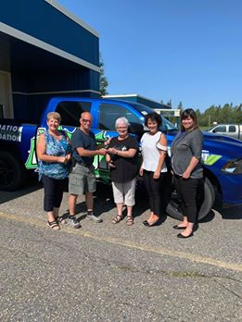
Winners of 2019 draw
$250.00 - Normand Labonté
$250.00 - Lance Costante
$500.00 - Bernard Lavoie
$1,500.00 - Manon Gagné
$2,500.00 - Larry Loubert
DODGE RAM 2019 – Jacques Rouleau

Slide 44
Fondation de l’hôpital de Smooth Rock Falls Hospital Foundation
Tirage 2020 Draw
We have filled the blanks?
Les gagnants !
Prize /prix 6 $250.00 Mona(Jacques) VanMarrem
Prize / prix 5 250,00 $ Thérèse Filion
Prize / prix 4 $500.00 Linda Cousineau
Prize / prix 3 1500,00 $ JF Séguin
Prize /prix 2 $2500.00 Angèle, Nat et Léo Marchand

Slide 45

Grand Prize /le grand prix #1
Mary and Yvon Lepage

Slide 46
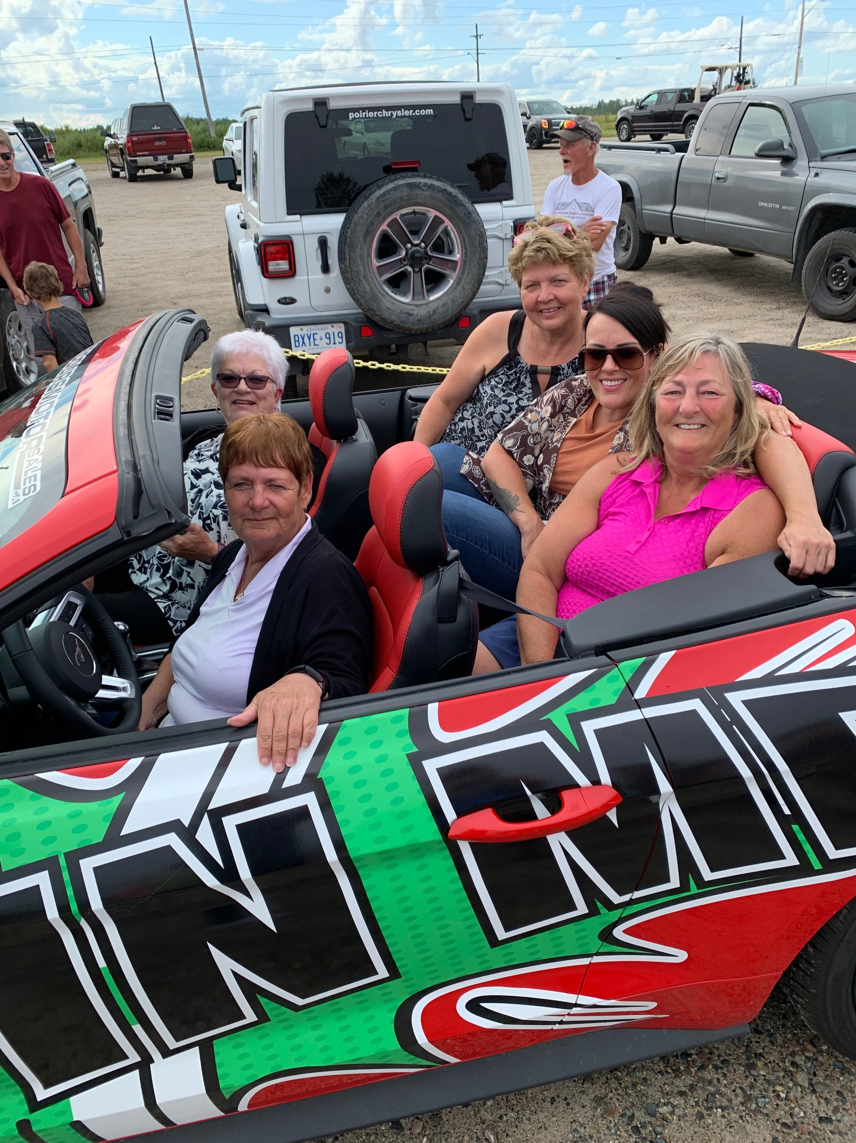
Members of the Foundation with the Mustang 2020 winner
Mary Lepage in driver’s seat !

Slide 47
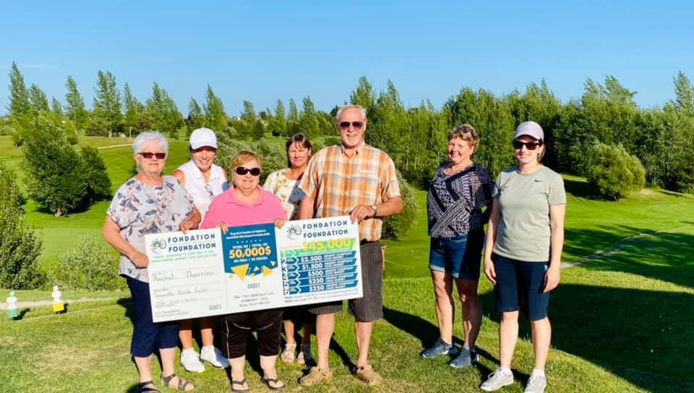
Members of the Foundation with the 2021 winner of $45,000
Rachel Therrien with her husband Denis.

Slide 48
Fondation de l’hôpital de Smooth Rock Falls Hospital Foundation
Tirage 2021 Draw
We have filled the blanks?
Les gagnants !
Prize /prix 6 $250.00 Clara Jacques
Prize / prix 5 250,00 $ Joanne Blake
Prize / prix 4 $500.00 André Filion
Prize / prix 3 1500,00 $ Chantal Tessier
Prize /prix 2 $2500.00 Monic Albert et Mona Klein

Slide 49
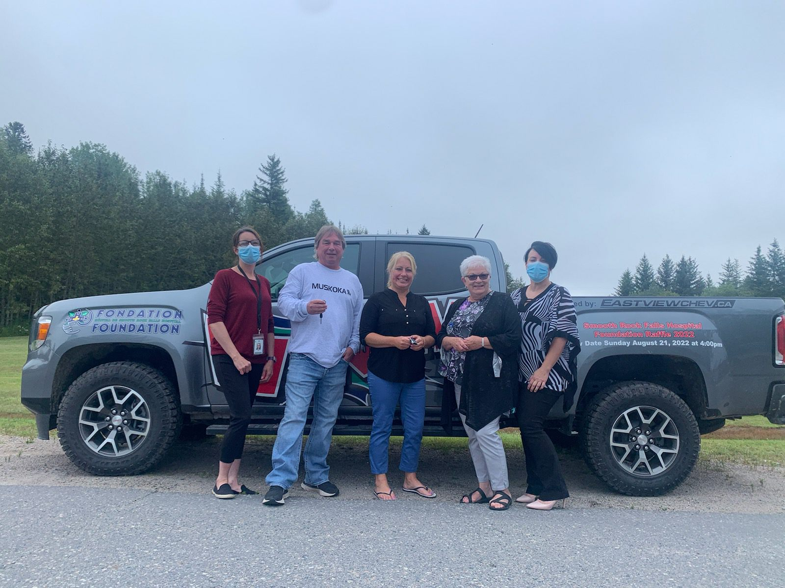
The winnier of the truck Neil Schell along with Tracy Gagnon who sold him the ticket, his partner Jennifer DeCaire, Marielle Cousineau president of the Foundation and Melonie Loubert CEO of the Smooth Rock Falls Hospital.
Neil Schell, 2022 annual draw winner

Slide 50
Fondation de l’hôpital de Smooth Rock Falls Hospital Foundation
Tirage 2022 Draw
We have filled the blanks?
Les gagnants !
Prize /prix 6 $250.00 Vondelle Oreskovich
Prize / prix 5 250,00 $ Jean-Guy Lamothe
Prize / prix 4 $500.00 Colleen Makillop
Prize / prix 3 1000,00 $ André et Éliane Bernier
Prize /prix 2 $2500.00 Al Dubord

Slide 51

Winner of the JEEP Cherokee 2023 Pierre Brunelle with members of the Smooth Rock Falls Hospital Foundation (left to right) Mérianne Latour, Hélène Gillissie, Mel Loubert, Marielle Cousineau et Nathalie Ethier, partner of the winner.
Winner of the 1rst prize of the 2023 draw Pierre Brunelle

Slide 52
Fondation de l’hôpital de Smooth Rock Falls Hospital Foundation
Tirage 2023 Draw
The winners !
Prize /prix 5 $250.00 Michel et Linda Semczyszyn
Prize / prix 4 250,00 $ Christian et Serge Labonté
Prize / prix 3 $300.00 Bill Kingsbury
Prize / prix 2 500,00 $ Lucie Brunet

Slide 53

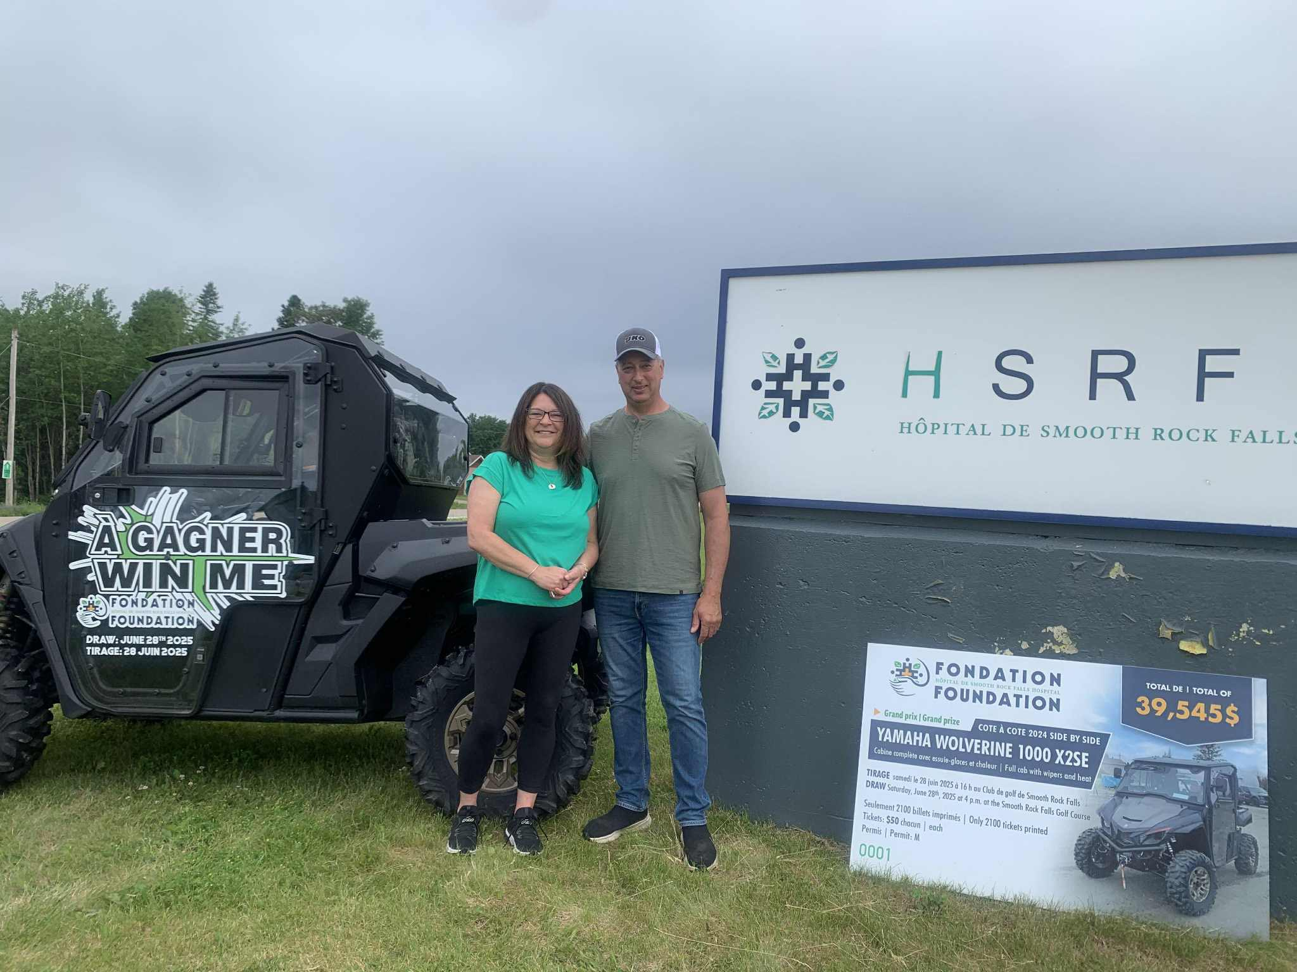
La gagnante de notre tirage annuel, Carole Pelletier Simard de Kapuskasing, était très heureuse de venir chercher son Côte à côte. On la voit en compagnie des membres de la Fondation de l’hôpital de SRFalls, gauche à droite, Mérianne Latour, Marielle Cousineau, l’heureuse gagnante Carole, Hélène (Gervais) Gillissie et Carole Cloutier. Félicitations Carole.
The winner of our annual draw, Carole Pelletier Simard, was very happy to pick up her Side by side. She is accompanied by SRFalls Hospital Foundation members, starting from the left, Mérianne Latour, Marielle Cousineau, the lucky winner Carole, Hélène (Gervais) Gillissie and Carole Cloutier. Congrats Carole.

Slide 54
We supported the 2021 Christmas Campaign to raise funds to update the X-ray department
Robert Connor Roger & Janis Plourde Thérèse Desbiens
Francine Gagnon Robert Béchard René Gravel
Jean-Marie et Alayne Couture Kyran Biglow
Anonymous Jean-Yves Marquis Andrew Smith
Eda Hildebrand Alain Couture Thérèse Bergeron
Hélène Poirier June & Gilles Bernard Georges Blais
Jean-Louis Lévesque Jules Gendron Line Thériault
Patricia & Michel Dubord Roger Therrien
Réjeanne Grenier Louise Blais Roger Gallant
Marcel & Thérèse Caouette Diane Bernier
Marie Bourgon Lucette Lamothe Francine Rioux
Léo Paul Gravel Nicole Boivin Robert Mainville Gilbert & Line Pelletier Rollande Dubé Edouard Gravel
Ernest & Marie Demers Denis Sergerie

Slide 55
We supported the 2021 Christmas Campaign to raise funds to update the X-ray department
Thomas & Dianna Rennie Carole Brunet Ron & Diane Browne
Gilles Daigle Lionel Perreault Viviane Gravel
Lorraine & Jacqueline Marcoux Kathy Taylor
Jeannette & Carmelle Brûlé Claude et Francine Lévesque
Ethel Léonard Benoit Lepage Line & Richard Mercier
Paulin & Roberte Hébert Marc & Myriam Gagnon
Marc & Chantal Albert Joanne Bennett Yolande Thomas
Albert Flooring & Remodeling Fern Gredger Julie Lavoie
Judith Lévis Marielle Cousineau Judith Lévis
Hélène Lamothe Jean-Marc Bérubé Dianne Riopel
Maurice & Jacqueline Guertin Eleanor Cousineau
Smooth Rock Falls Pharmacy John Mc Neish & Francine Lagace
Ubald & Emilienne Mercier Philippe et Agathe Fortin Yvon St-Pierre
Maurice Fraser Service Centre Brigitte Couture
Gilles & Suzanne Brunet

Slide 56
We supported the 2021 Christmas Campaign to raise funds to update
the X-ray department
Gilles & Audrey Loiselle Ginette Chartrand Lisette Boucher
Waleston Labonté André Mainville Clara & Emile Jacques
Héléne (Gervais) Gillissie Chevaliers de Colomb Diane & Robert Richer
Josette & Guy Rockburn Pauline & Carol Labonté Cécile Gagnon
Linda Cousineau Gilbert Lacroix Germain Petit
Roland & Denise Daoust Louise Priebe-Gagnon Manon Malenfant
Lina Arseneault Darryl Demers Jacqueline Dubord
Lise & Lawrence Simpson Nicole & Agustin Landry Léona Mattuissi
Suzanne & Guy Boivin

Slide 57
We supported the 2022 Christmas campaign to raise funds to buy new beds for the LongTerm Care Unit
LéoPaul Gravel Nicole & Augustin Landry Alain Couture
Line Thériault Denise & Jean-Pierre Frénette Kyran Biglow
Waleston Labonté Normand & Diane Labonté Manon Malefant
Ronald Lamothe Susan & Claude Therrien Betsy & Robert Connor Janis & Roger Plourde Myriam & Marc Gagnon Micheline Hudson
Louise Blais Rose Anna & Gérald Petit Conrad Labonté
Lina & André Mercier Ethel Léonard Germain Petit
Faye & Paul Desbiens Marie & Ernest Demers Robert Mainville
Ann & Gilbert Lacroix Patricia & Michel Dubord Yvon St-Pierre
Irène Gravel Pauline & Carol Labonté Dave Marlow
Paul Guénette Jeannine Bédard Diane Bernier
Denis Sergerie Lynne & Gilbert Pelletier Mimi & Ubald Mercier
Jean-Marc Huet Jacqueline & Maurice Guertin Jacqueline Marcoux

Slide 58
We supported the 2022 Christmas campaign to raise funds to buy new beds for the LongTerm Care Unit
Filles d’Isabelle, Cercle Ste Thérèse de l’enfant de Jésus Rolande Dubé
Thérèse Caouette Suzanne & Gilles Brunet Jean-Yves Marquis
Ian Colaiezzi Denise St-Pierre Sheila & James Boucher
Yolande Thomas Jean-Louis Lévesque Bruno Goyette
Kathy Taylor Francine & Claude Lévesque Suzanne Ethier
Clément Racette Robert Béchard Denis Lasalle
Hélène Gillissie Denise Jolie Brigitte Couture
Marielle Cousineau Angela & Christine Williams Nicole Boivin
Diane Papineau Linda Cousineau & Roger Marinier
Edouard Gravel Thomas & Dianna Rennie Eleanor Cousineau
Maurice Fraser Service Centre Ginette Chartrand
Thérèse Bergeron Lise & Larry Simpson Arlette & Jules Lepage
Theresa Phillips Richard Graine & Lina Béchard Raymond Labonté
Albert Flooring & Remodeling Jacqueline Dubord
Hélène & Jean-Guy Poirier Jean-Yves & Nicole Leblanc
Dianne & Ron Browne

Slide 59
We supported the 2023 Christmas Campaign to help purchase much needed medical equipement.
Jean-Pierre Frénette Vivianne Gravel Robert Mainville
Suzanne Brunet Line Thériault Jean-Marc Huet
Thérèse Caouette Mike Hudson Diane Richard
LéoPaul Gravel Judith Lévis Augustin Landry
Jean-Guy & Hélène Poirier Louis Gagnon Normand Labonté
Louise Blais Francine Gagnon Philippe Fortin
Leslie Gagnon Germain Petit Thérèse Bergeron
Denis Sergerie Kathy Taylor Irène Gravel
Ernest & Marie Demers Marc Gagnon Ron Lamothe
Diane Richer Clément Desrochers Denis Contant
Diane Bernier Sue & Claude Therrien Jean-Yves Marquis Lorraine & Jaqueline Marcoux Louise Priebe Gagnon Ethel Léonard
Jeannine Bédard Jean-Louis Lévesque Roger & Janis Plourde
Manon Boivin Waleston Labonté Gilles Daigle
Josette Rockburn Lucette Bélanger Mona Bélanger

Slide 60
We supported the 2023 Christmas Campaign to help purchase much needed medical equipment.
Claude & Francine Lévesque Lise Breton Clement Desrochers
Ginette Chartrand Kyran Biglow Yolande Fortier
Lise Côté Pelchat Fern Gredger Rita Brunet
Maurice Fraser Service Centre Yolande Thomas Gilles Bernard
Paul Guénette Lucienne Lafrenière Brigitte Couture
Marcel Parisé Carole Cloutier Emile & Clara Jacques
Benoit Lepage Denise Daoust Lisette Boucher
Marcel Pelchat Audrey & Blaise Tremblay
Donald Lamontagne Bruno Goyette Jeanette & Carmel Brulé
Edouard Gravel Mary & Yvon Lepage Marielle Cousineau
Hélène Gillissie Tracy Mattoon Anonymous
Alain Couture Arleen Johnston Tara Lise Gagnon
Lina Arseneault Denis Brûlé Gilbert & Lynne Pelletier
Nicole Boivin Léo Blanchette Suzanne Boivin
Albert Flooring & Remodeling Rollande Dubé Jacqueline Dubord
Roger Gallant

Slide 61
We supported the 2024 Christmas Campaign to help purchase a digital wheel chair scale.
Les Filles d’Isabelle, Cercle Ste Thérèse de l’enfant Jésus Hélène (Gervais) Gillissie
Bruno Goyette Yolande Fortier Kathy Taylor
Kyran Biglow Suzanne Boivin Germain Petit
Yvon & Gisèle St-Pierre Mike Hudson Chantal Deschamps
Roger & Janis Plourde Diane Richard Line Thériault
Jean-Guy & Hélène Poirier Waleston Labonté Jeannine Bédard
Marc & Myriam Gagnon Léo-Paul Gravel Ethel Léonard
Denise & Jean-Pierre Frénette Francine Rioux Guy Rochon
Augustin & Nicole Landry Manon Malenfant Flo Gagnon
Jean-Yves & Colette Marquis Lucette Levesque Lorraine E Dorr
Thérèse Bergeron Fournier Sue & Claude Therrien Josette Rockburn
Clara & Emile Jacques Gilles & Suzanne Brunet Clément Desrochers
Ernest & Marie Demers Irène Gravel Denis Sergerie
Norman & Diane Labonté Nicole Boivin Diane Bernier

Slide 62
We supported the 2024 Christmas Campaign to help purchase a digital wheel chair scale.
Claude & Francine Levesque Viviane Gravel Alayne & Jean Couture
Rémi Gravel & Monique Boucher Lina Arseneault Ian & Lucie Colaiezzi
Wayne & Diane Martin Francine Gagnon Robert Mainville
Pauline & Robert Richard Marielle Cousineau Viviane Gravel
Jean-Louis & Cécile Lévesque Louise Blais Dianne Browne
Donald Lamontagne & Denise Jolie Alberta Morel Gilles Bernard
Edouard Gravel Jacquelin Ratté Jacqueline Marcoux
Carmel et Jeannette Brûlé Gérald & Rose Anna Petit
Maurice Fraser Service Centre John A McNeish & Francine Lagace
Gérard & Denise Fortier Richard & Lyne Mercier
Gilbert & Lynne Pelletier Gabrielle & Maurice Jacques
Jacqueline Dubord Rollande Dubé Ginette Chartrand
Laurette Gagné

Slide 63

Get involved, become a volunteer !
The Smooth Rock Falls Hospital Foundation is looking for volunteers to fill positions on the Board of Directors!
To join the Council, please send a letter to the foundation indicating your interest. Everyone who sits on the board must be bilingual.
Volunteering for the foundation is doing something different for the betterment of your community.
To contact us: fondation@srfhosp.ca or 705-338-3323

Slide 64
The Foundation members thank everyone for their ongoing support. Our success is caused by your generosity!

